Slide 1


NEXT GEN EMPLOYABILITY PROGRAM
CREATING A FUTURE-READY WORKFORCE
Student Name :
Pratik Sunil Gunjal
Student ID :
College Name :
STU65818c49b6d7f1702988873
Amrutvahini College of Engineering Sangamner

Slide 2
CAPSTONE PROJECT SHOWCASE
Recipe Sharing Platform with React and ExpressJS
(A real-time collaborative application for recipe management)
Abstract | Problem Statement | Project Overview | Proposed Solution | Technology Used | Modelling & Results | Conclusion | Q&A

Slide 3
Abstract
1
A web-based platform where users can create, share, and manage recipes in real-time.
2
User authentication, real-time updates, document storage, and collaboration.
3
MERN Stack (MongoDB, Express.js, React.js, Node.js).
4
Emphasizes seamless user experience with intuitive UI/UX, enabling effortless recipe discovery, sharing, and collaboration in real-time.

Slide 4


Problem Statement
Difficulty in managing and sharing recipes across different platforms.
Lack of a centralized repository with real-time collaboration features.
No easy way to categorize, store, and modify recipes collaboratively.

Slide 5

Project Overview
The platform allows users to:
Create, edit, and delete recipes.
Share recipes with other users.
Collaborate and edit in real-time.
Authenticate users securely.
Focus on scalability and ease of use.

Slide 6
Proposed Solution
Develop a full-stack application using React for the frontend and Express.js for the backend.
Use MongoDB for recipe storage and real-time updates with WebSockets.
Implement user authentication and authorization.
Responsive UI for seamless experience across devices.

Slide 7
Technology used
Frontend: React.js (Component-based UI, Hooks, State Management).
Backend: Express.js (REST API, authentication, real-time WebSockets).
Database: MongoDB (Document-oriented storage, flexible schema).
Authentication: JSON Web Tokens (JWT) for secure user access.
Real-time Features: WebSockets for live updates.

Slide 8
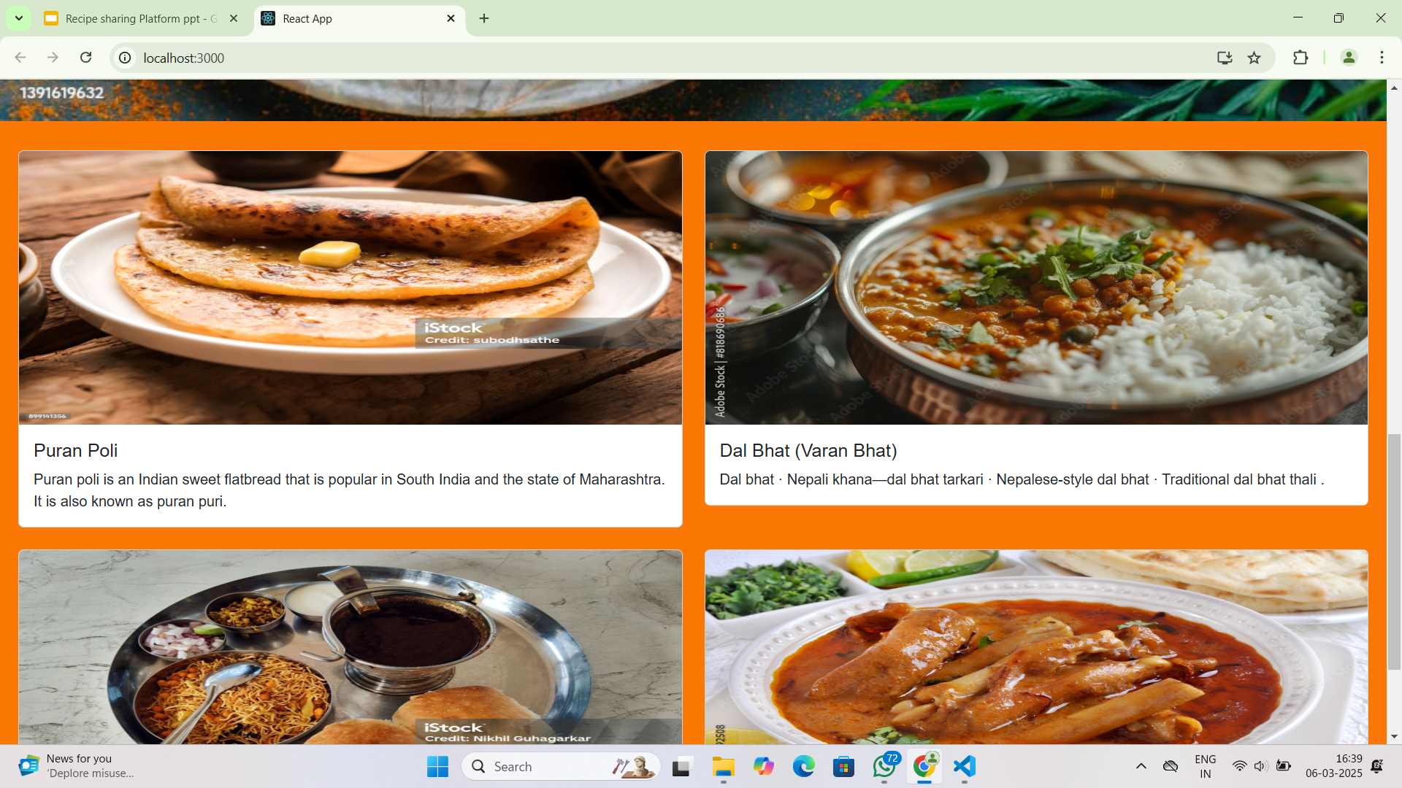
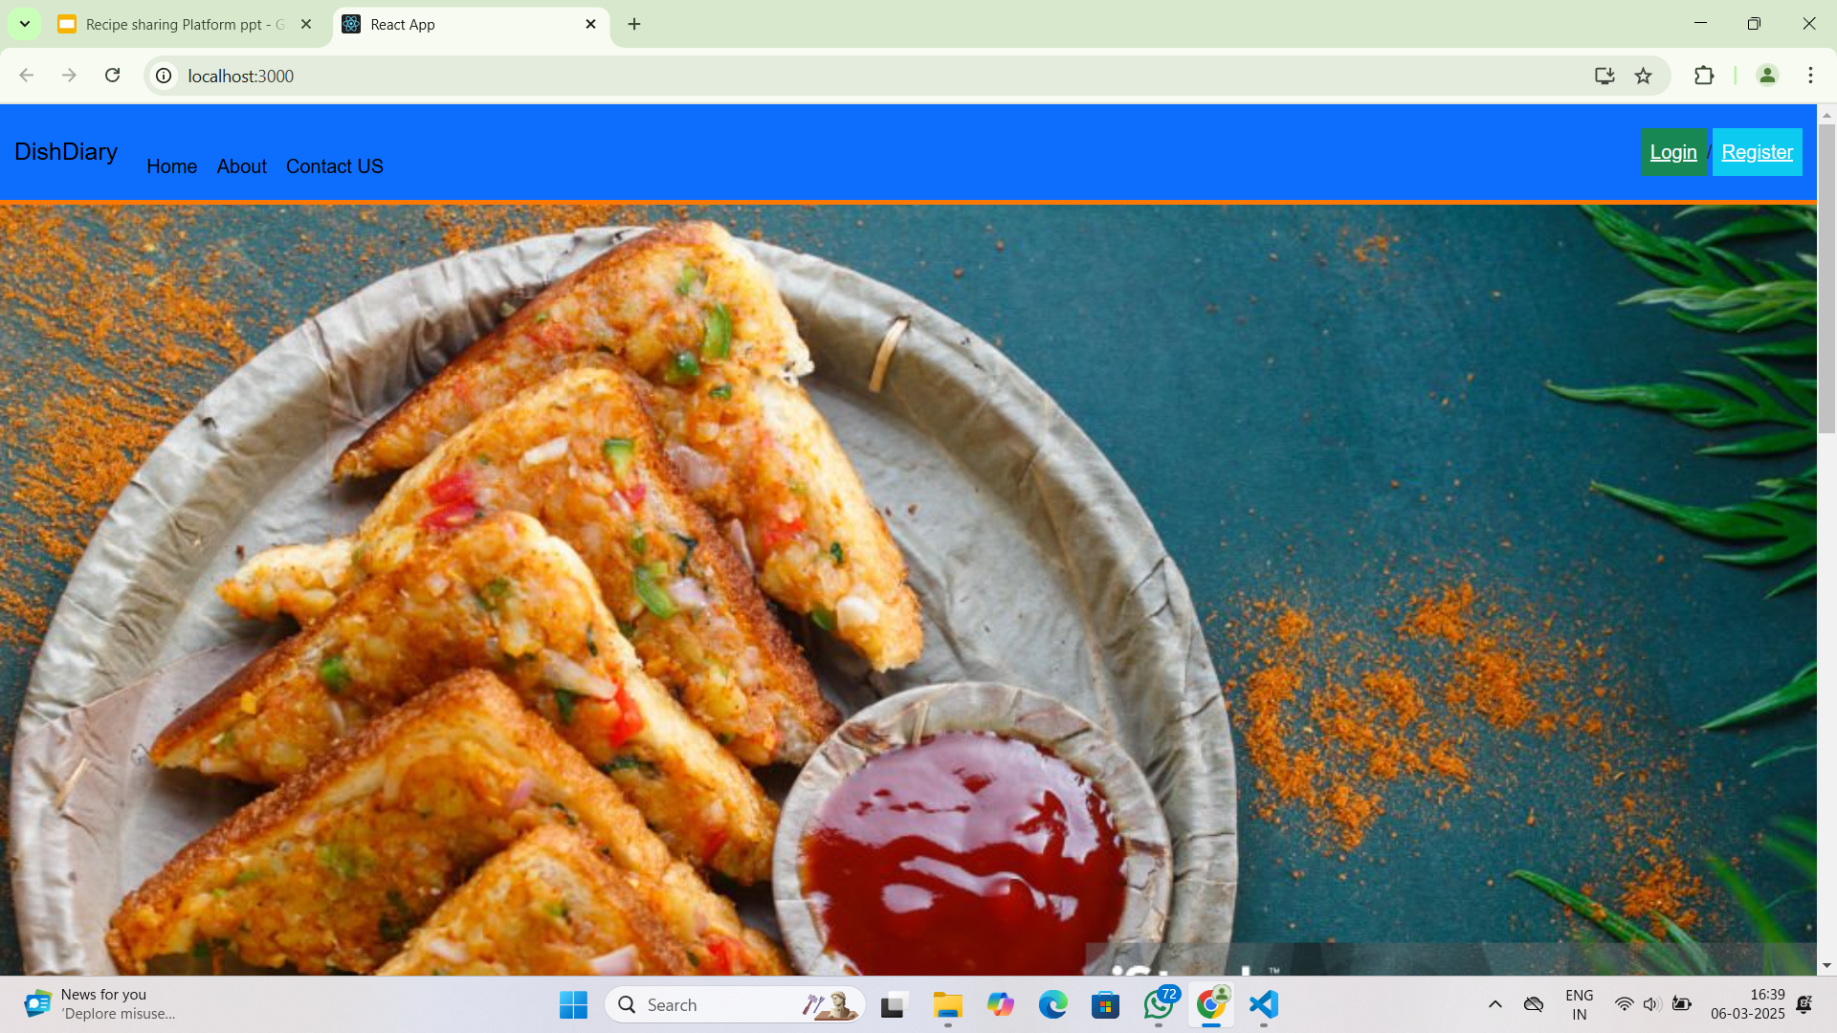
Modelling & Result

Slide 9
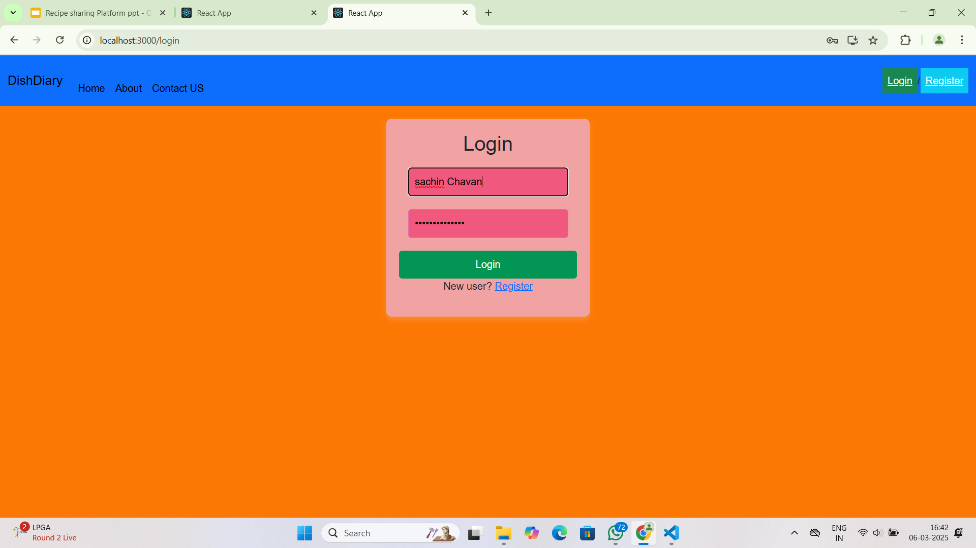
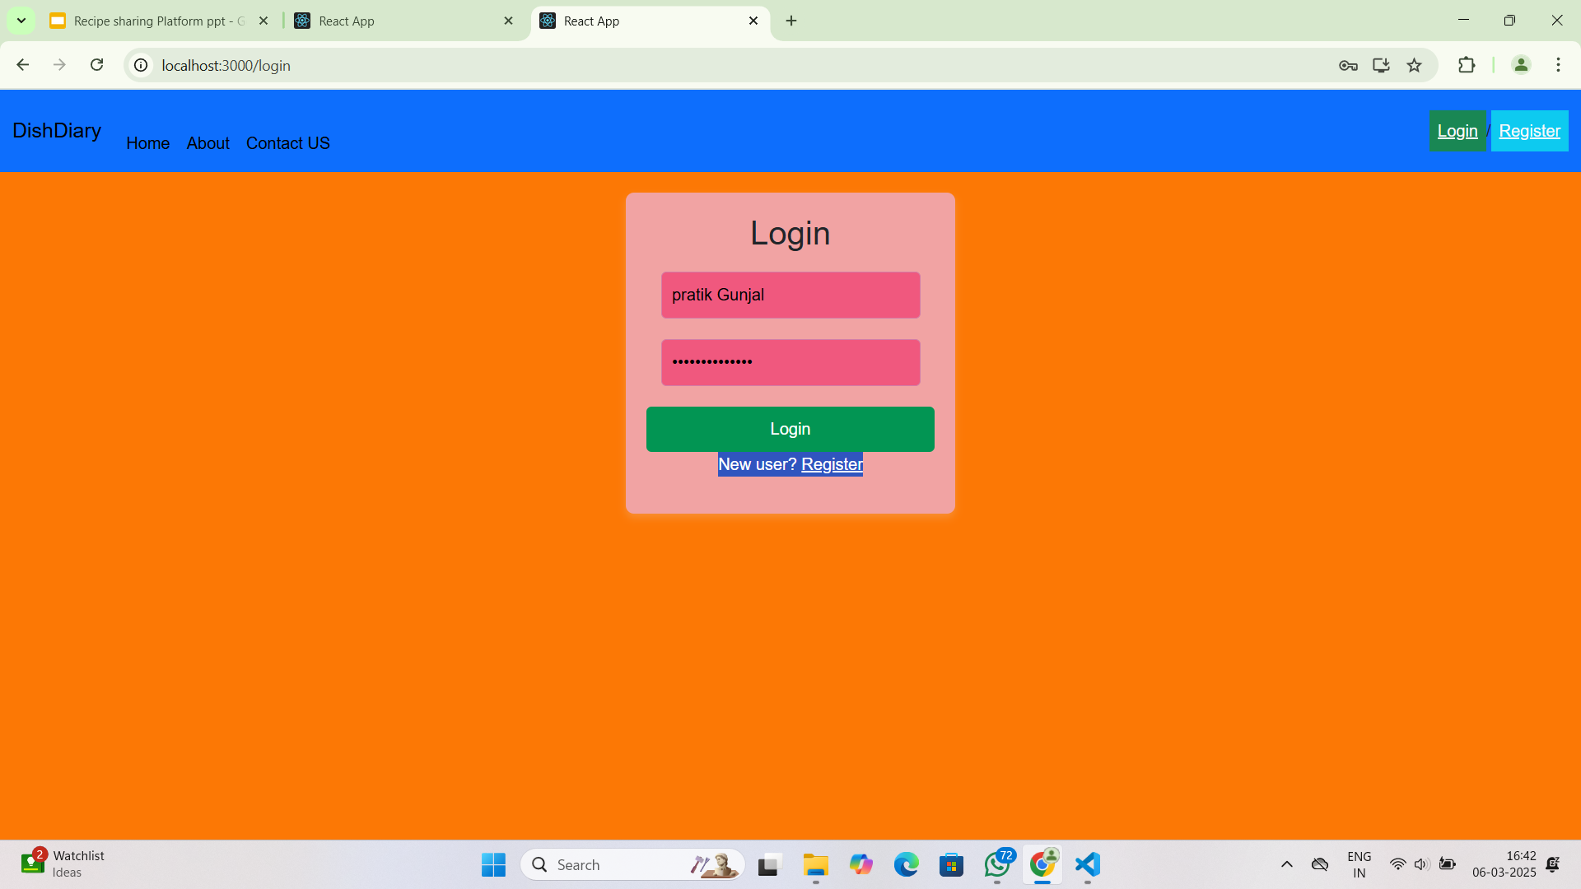
Modelling & Result

Slide 10
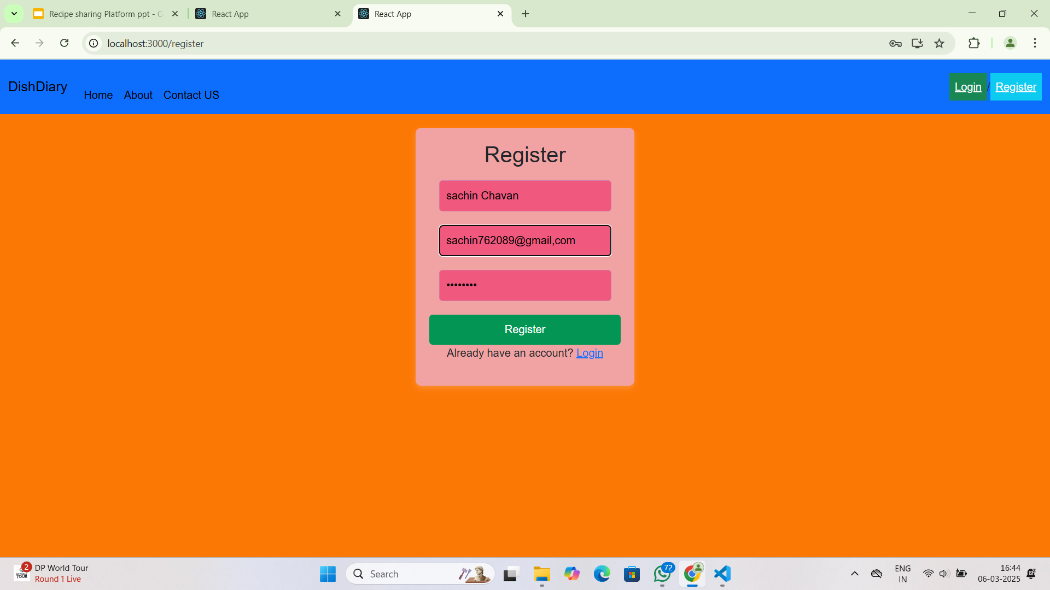
Modelling & Result

Slide 11

Conclusion
Efficient Recipe Management: The platform provides a seamless way for users to create, share, and collaborate on recipes in real-time.
Scalable & Secure: Built using the MERN stack with robust authentication, ensuring data integrity and user security.
Real-Time Collaboration: WebSockets enable instant updates, making recipe editing and sharing interactive.
User-Centric Experience: Intuitive UI/UX for easy navigation and accessibility across devices.
Future Scope: Potential enhancements include AI-powered recipe recommendations, integration with social media, and a dedicated mobile application.
Learning & Growth: Gained hands-on experience with full-stack development, authentication, database management, and real-time features.

Slide 12


Notes:
Thank You !!

